Slide 1

Class of 2025
Pinellas Park High School
Wednesday May 28 @ 7:30 pm
BayCare Sound

Slide 2
Grad Fees and
Cap and Gown
The $45 Graduation fee covers the BayCare Sound Expenses.
The Cap and Gown MUST BE PURCHASED THROUGH JOSTENS.
BOTH FEES MUST BE PAID BY FRIDAY, MAY 16TH.
Links for both items are available on the school website under Activities / Class 2025
If you have any questions, please see Ms. Verdenksy at the end of this meeting or in G2 during lunch.

Slide 3
HOUSEKEEPING
Please take care of all obligations before Friday, May 16 (return LAPTOPS & chargers, textbooks, library books, uniforms, etc)
Laptops & chargers should be returned as soon as your tests are done. Return computers and chargers to the front office or to the Media Center. There will be a charge for lost devices, AND YOUR DIPLOMA COULD BE HELD. Senior obligations must be settled before May 16.

Slide 4
Final transcript request / senior survey
Log in to Clever
Log in to Xello
Halfway down on right-hand side, complete 2025 Senior Exit Survey by clicking "take survey"

Slide 5
Code of Conduct
Please read the BLUE document.
All graduates AND parent/guardians must sign the code of conduct and return the bottom signed portion to Ms. Verdensky in F7 no later than Friday, May 9th
NO CODE, NO WALKING!

Slide 6
Dress Code
DRESS CODE:
Female graduates shall wear black dress shoes and the Jostens BLUE GOWN WITH RED Cuffs and White Embroidery, and a cap with the included tassel. Any color dress or skirt/blouse. NO ADDITIONS TO GOWN, CAP, TASSEL, OR HAIR ARE ALLOWED.
Male graduates will wear black shoes and socks, black dress slacks, white dress shirt and tie, and the Jostens BLUE GOWN WITH RED Cuffs and White Embroidery, and a cap with the included tassel. NO ADDITIONS TO GOWN, CAP, TASSEL, OR HAIR ARE ALLOWED.
Please do not wear heels, as there is uneven terrain, stairs, and substantial walking. We do not want anyone to stumble or have difficulty walking during the procession.
IMPROPER DRESS:
Anything other than what is described below shall be considered improper dress for seniors. Honors cords and CJA, First Responders, Coast Guard, and NHS stoles are permitted.

Slide 7
IMPROPER BEHAVIORS:
GRADUATES ARE NOT PERMITTED TO HAVE CELL PHONES DURING THE CEREMONY. Please leave electronic devices with a family member. Cell phones WILL be taken at check-in if you bring them.
IMPROPER NOISES OR DISTRACTION BEFORE OR DURING THE CEREMONY
BEING UNDER THE INFLUENCE OF ALCOHOL OR DRUGS
DETONATING ANY EXPLOSIVE DEVICES OR TOSSING INFLATABLES
GIVING OBSCENE, SUGGESTIVE, OR DISRESPECTFUL GESTURES
THROWING OF CAPS DURING OR AFTER THE CEREMONY (tossed caps will be kept at school, and parents must meet with Mr. Larson to collect them); they can harm other students.

Slide 8
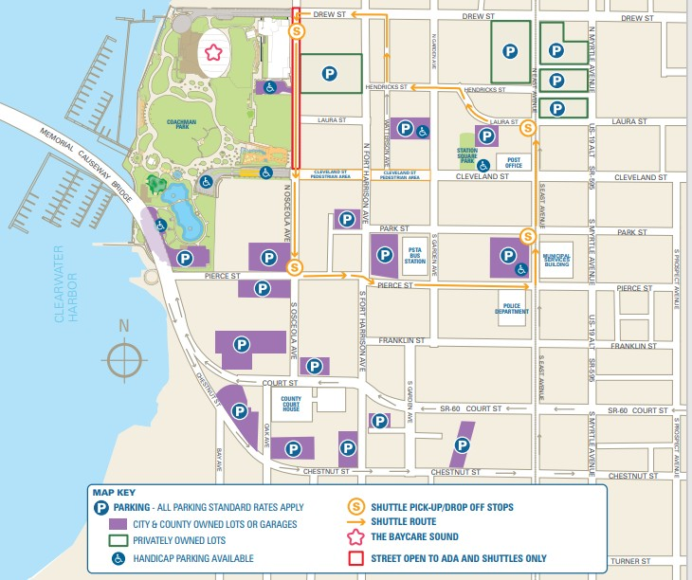
Getting to BayCare Sound

Slide 9
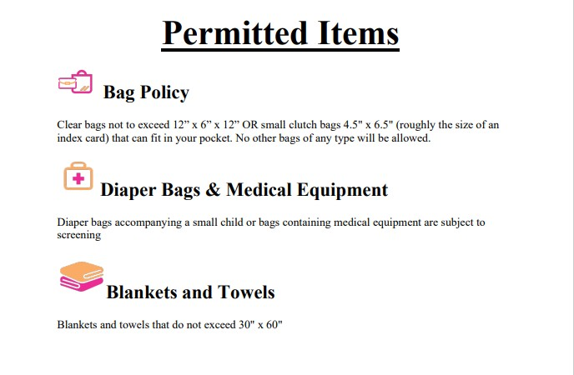
BayCare Sound Permitted Items

Slide 10
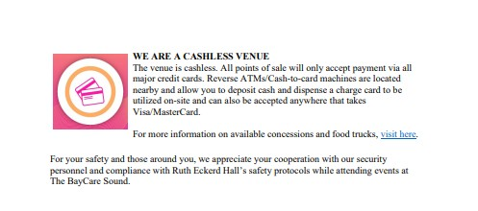
BayCare Sound Cashless

Slide 11
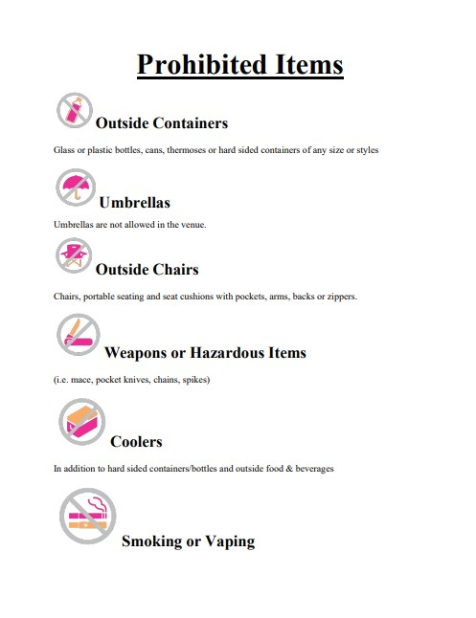
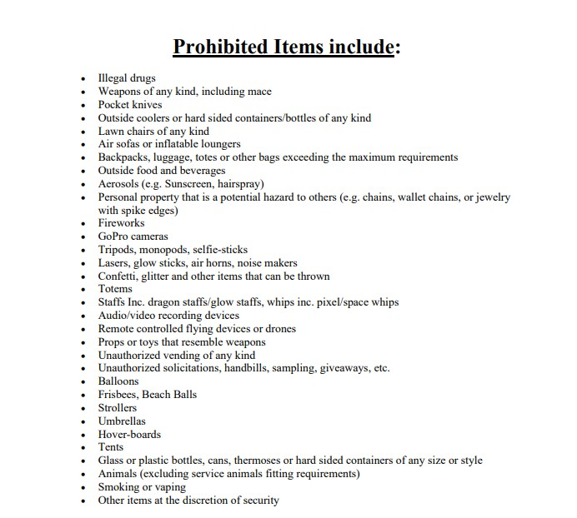
BayCare Sound Prohibited

Slide 12
WHAT TO BRING:
Cap & Gown & tassel
  Only SCHOOL-ISSUED TASSELS AND STOLES ARE PERMITTED. No other adoration of the cap, gown, or attire is permitted.
WHAT NOT TO BRING:
Cell phones (WILL be collected at check in), camera, sunglasses, purse, wallet, keys.

Slide 13
Day of Graduation: Live streamed, link on PCS website.
Arrive at the Clearwater Library at the top of BayCare Sound no later than 6:30 pm.
Students will be staged in the library.
  Upon arrival, check in and get your NAME CARD, RICHARD ALLEN SCHOLARSHIP COIN, AND MEDALLION. DO NOT LOSE THEM!
  Students MUST HAVE GIVEN THEIR ELECTRONICS TO A FRIEND OR FAMILY MEMBER, OR TURN THEM IN TO BE COLLECTED AND RETURNED AT THE END OF THE CEREMONY.
  Follow the instructions to get in line by your assigned number. There will be two lines for the procession. Please keep your SPACE and PACE once we exit the library.
  Do NOT Lose Your Card!

Slide 14
Day of Graduation: Exiting the Library
Once we exit the library, we will proceed down the right (facing the stage) walkway.
There will be a Patriot Staff Member for every 25 graduates to help maintain poise and procession.
The bell will be ringing under the Library Overhang.
We will pass by some of our guests – PLEASE MAINTAIN RESPECT FOR ALL PARTICIPANTS AND KEEP THE PROCESSION RESPECTFUL OF ALL.
We will continue to the front of the stage and turn left towards the center aisle.
Once we reach the center aisle, graduates will face the guests and be directed to their seats by the number of seats per row. STAY STANDING UNTIL DIRECTED TO SIT.
Every row does not have the same number of seats!!!!
PLEASE PAY ATTENTION WHEN WE ARE COUNTING SEATS!!!!!

Slide 15
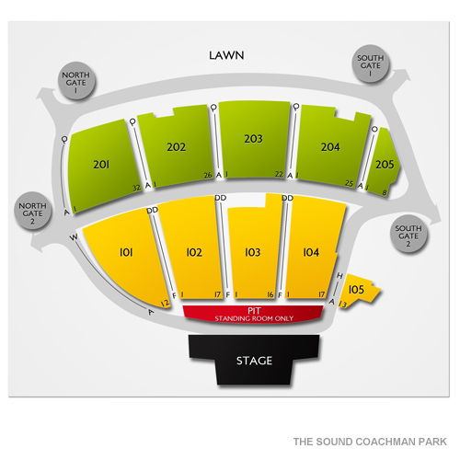
Day of Graduation: Stage Overview
The Library is just above the lawn Area
All GRADUATES AND GUESTS WILL ENTER AT South Gate 1
All GRADUATES AND STAFF will exit the Library by South Gate 1, and proceed toward North Gate 1, then down the pathway towards the stage.
Graduates will be seated in the front of 102, 103, and 104 with a center aisle.
Staff will sit behind the graduates, and ALL GUESTS WILL SIT BEHIND THE DESIGNATED GRADUATE AND FACULTY AREA.

Slide 16
Day of Graduation: Graduates and Staff are at their Seats
REMAIN STANDING UNTIL DIRECTED TO SIT
MAINTAIN PATRIOT PRIDE AND BE AN UPSTANDER
The National Anthem will be played via a video recording on the screens
The Alma Mater will be played via a video recording on the screens.
Mr. Larson will address the graduates and guests.
Once directed to take a seat, please do so in an orderly fashion.
Stage guests will be introduced, and speeches will be given.
Remain a Patriot Upstander and listen and embrace the celebration – it’s what you and all of your peers have worked for.
All families and graduates want to enjoy their celebration, so remain respectful of all throughout the ceremony.

Slide 17
Day of Graduation: Stage Time
Graduates will exit the rows in the same manner in which they entered.
Facing the stage, graduates will be directed towards the right side of the stage.
Graduates will proceed around the back right of the stage, give their name card to the photographer for a backstage photo.
Follow the directions up to the back of the stage, and pronounce your name to the speaker.
WHEN GIVING YOUR NAME, SPEAK SLOWLY AND CLEARLY.
Proceed towards Mr. Larson.

Slide 18
Day of Graduation: Diploma Time
Mr. Larson hands you a diploma cover, drop the coin from your right hand, hand shake, SMILE (picture).
WALK towards the stage guests to your right, be courteous and polite – shake hands, smile, be a positive representative of Patriot Pride.
Continue RESPECTFULLY ACROSS THE STAGE.
  Respectful of all graduates and guests!
Faculty will direct you back to your seat through an adjoining building and back to the right side of the rows. Remain an upstander the entire way!
When you get to your seat, sit down immediately, so seniors behind you can see.

Slide 19
Day of Graduation: The last Graduate crosses the stage
After the last senior crosses the stage, applause from the audience…
Farewell speech by the President of the Exec. Board…
The official “moving” of the tassels, directed by Mr. Larson (from right to left)!! You are an alumnus now!
Wait for the faculty to direct you, follow the line, and move quickly.
  You will exit in the same manner in which you arrived and head back to the library.
As you walk, you may wave to your family, but please maintain your respect for all and keep the pace with those in front of you.

Slide 20
Day of Graduation: Collecting the ACTUAL DIPLOMIA
Return to the setup area and quickly PICK UP YOUR DIPLOMA!
If you borrowed any material, you must return it before you can get your diploma. If there are any issues, PLEASE call the school on THURSDAY.
Don’t forget your phone if it was collected
Meet your family in front of THE SOUTH GATE: the same gate you entered.
Move away from the entrance to allow everyone to find their families.
It will be dark, so pictures ARE ENCOURAGED TO BE TAKEN ALONG THE WATERFRONT BEFORE THE CEREMONY. BUT DO NOT APPROACH THE SOUTH GATE ENTRANCE BEFORE 6:30 PM.

Slide 21
Day of Graduation: Congratulations ☺
WE ARE PROUD OF YOU
WE KNOW YOU WILL MAINTAIN THE PATRIOT PRIDE AT THE CEREMONY
WE LOVE YOU
AND YOU WILL NOW and FOREVER BE A PATRIOT ALUNIUS
I WILL DEARLY MISS MANY OF YOU!
Please email me at verdenskyk@pcsb.org if you have any questions, or STUDENTS MAY VISIT ME IN G2 DURING LUNCH. PLEASE DO NOT INTERUPT MY CLASSES.
THANK YOU!

